Slide 1
CONGESTION CONTROL
Prepared by
Divya K S
Adi Shankara Institute of Engineering & Technology
Kalady

Slide 2
CONGESTION CONTROL
Too many packets present in (a part of) the network causes packet delay and loss that degrades performance.
This situation is called congestion.

Slide 3
Factors that Cause Congestion
Packet arrival rate exceeds the outgoing link capacity.
Insufficient memory to store arriving packets
Bursty traffic
Slow processor
If the routers' CPUs are slow at performing queuing buffers, updating tables, etc., queues can build up, even though there is excess line capacity

Slide 4
Packet arrival rate exceeds the outgoing link capacity.
If suddenly, a stream of packet start arriving on three or four input lines and all need the same output line.
In this case, a queue will be built up.
If there is insufficient memory to hold all the packets, the packet will be lost.
Increasing the memory to unlimited size does not solve the problem.
This is because, by the time packets reach front of the queue, they have already timed out (as they waited the queue). When timer goes off source transmits duplicate packet that are also added to the queue.
Thus same packets are added again and again, increasing the load all the way to the destination.

Slide 5
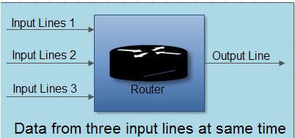
Packet arrival rate exceeds the outgoing link capacity.

Slide 6
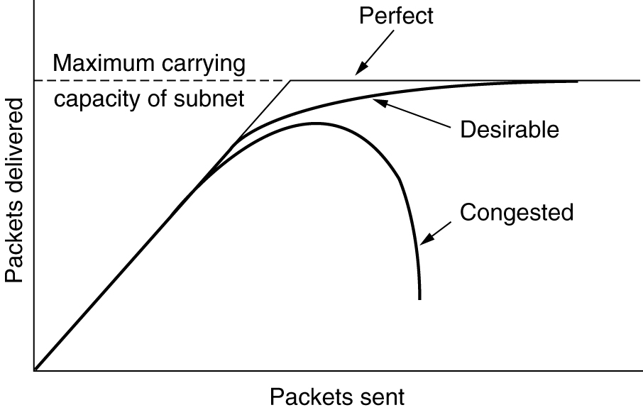
Congestion
When too much traffic is offered, congestion sets in and performance degrades sharply.

Slide 7
Congestion
When the number of packets hosts send into the network is well within its carrying capacity, the number delivered is proportional to the number sent.
If twice as many are sent, twice as many are delivered.
However, as the offered load approaches the carrying capacity, bursts of traffic occasionally fill up the buffers inside routers and some packets are lost.
These lost packets consume some of the capacity, so the number of delivered packets falls below the ideal curve. The network is now congested

Slide 8
Congestion Control vs Flow Control
Congestion control is a global issue – involves every router and host within the subnet
Flow control – scope is point-to-point; involves just sender and receiver.

Slide 9
Types of Congestion Control
In general, we can divide congestion control mechanisms into two broad categories:
Open-loop congestion control
Closed-loop congestion control

Slide 10
open-loop congestion control
In open-loop congestion control, policies are applied to prevent congestion before it happens.
In these mechanisms, congestion control is handled by either the source or the destination

Slide 11
Closed-Loop Congestion Control
Closed-loop congestion control mechanisms try to alleviate congestion after it happens

Slide 12
open-loop congestion control
Open loop solutions attempt to solve the problem by good design, to make sure congestion does not occur in the first place.
Once the system is up and running, midcourse corrections are not made
Tools for doing open-loop control include
deciding when to accept new traffic
deciding when to discard packets
which ones to discard
making scheduling decisions at various points in the network

Slide 13
Closed-Loop Congestion Control
Closed loop solution based on the concept of a feedback loop.
This approach has three parts when applied to congestion control
Monitor the system and detect when and where congestion occurs.
Pass information to where action can be taken.
Adjust system operation to correct the problem.

Slide 14
General Principles of Congestion Control
open loop algorithms are divided into
ones that act at the source
ones that act at the destination
closed loop algorithms are divided into
explicit feedback
implicit feedback
In explicit feedback algorithms, packets are sent back from the point of congestion to warn the source.
In implicit algorithms, the source deduces the existence of congestion by making local observations, such as the time needed for acknowledgements to come back

Slide 15
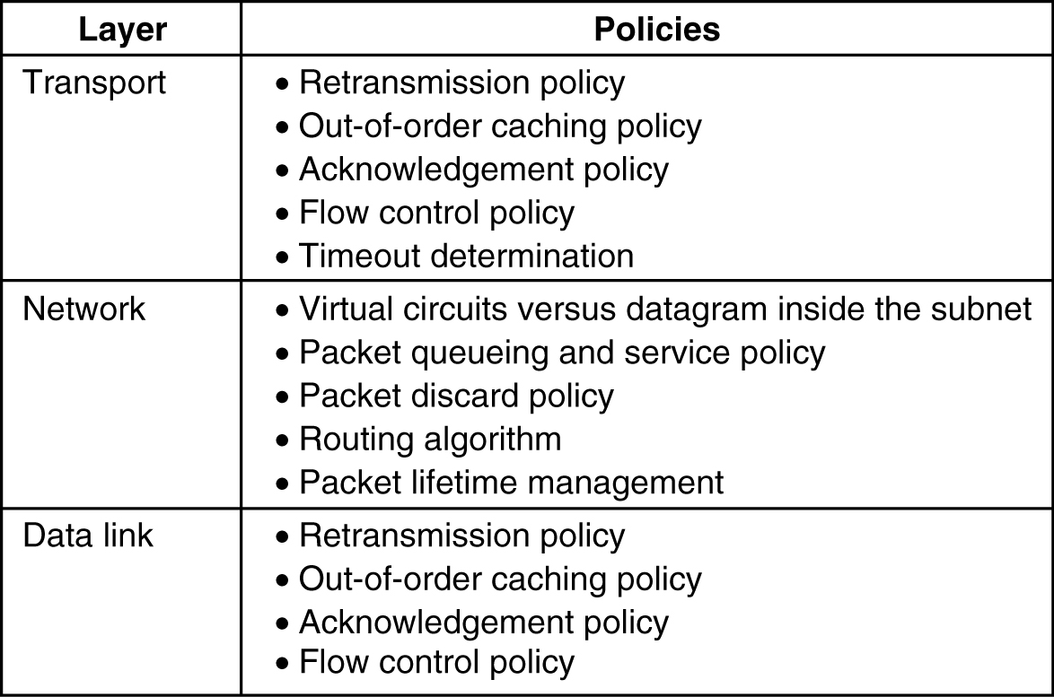
Congestion Prevention Policies
5-26
Open loop Policies that affect congestion.

Slide 16
Congestion Prevention Policies
Policies considered in the Data link layer
Retransmission policy:
how fast a sender times out and what it transmits upon timeout
go back n will put a heavier load on the system than selective repeat
Out-of-order caching policy:
selective repeat is clearly better than go back n
Acknowledgement policy:
Piggybacking onto reverse traffic may help
But extra timeouts and retransmissions may happen.
Flow control Policy:
a small window reduces the data rate and thus helps fight congestion

Slide 17
Congestion Prevention Policies
Policies considered in the Network layer
Choice of virtual circuits vs datagrams:
affects congestion since many congestion control algorithms work only with virtual-circuit subnets
Packet queuing and service policy:
relates to whether routers have one queue per input line, one queue per output line, or both
also relates to the order in which packets are processed (e.g., round robin or priority based)
Packet Discard policy :
rule telling which packet is dropped when there is no space
Routing algorithm:
Good algorithm can help avoid congestion by spreading the traffic over all the lines

Slide 18
Congestion Prevention Policies
Packet lifetime management:
deals with how long a packet may live before being discarded
If it is too long, lost packets may block up the works for a long time
If it is too short, packets may sometimes time out before reaching their destination, thus inducing retransmissions
Policies considered in the Transport layer
Same issues as in data link layer plus
Timeout determination:
determining the timeout interval is harder because the transit time across the network is less predictable
If the timeout interval is too short, extra packets will be sent unnecessarily.
If it is too long, congestion will be reduced but the response time will suffer whenever a packet is lost.

Slide 19
Congestion Control in Virtual-Circuit Subnets and datagram subnet
Congestion Control in Virtual-Circuit Subnets
Admission control
Allow new virtual circuit avoiding congested routers
Congestion Control in Datagram Subnets
Warning bit
Choke packets
Load shedding
Random early discard

Slide 20
Congestion Control in Virtual-Circuit Subnets
Techniques is
Admission control
Idea of admission control is :
once congestion has been signaled ,no more virtual circuit are set up until the problem is solved

Slide 21
Congestion Control in Virtual-Circuit Subnets: second approach
Alternative approach to allow new virtual circuit avoiding congested routers
Eg: Suppose that a host attached to router A wants to set up a connection to a host attached to router B. Fig. (a)
Normally, this connection would pass through one of the congested routers.
To avoid this situation, redraw the network as shown in Fig. (b), omitting the congested routers and all of their lines.
The dashed line shows a possible route for the virtual circuit that avoids the congested routers.

Slide 22
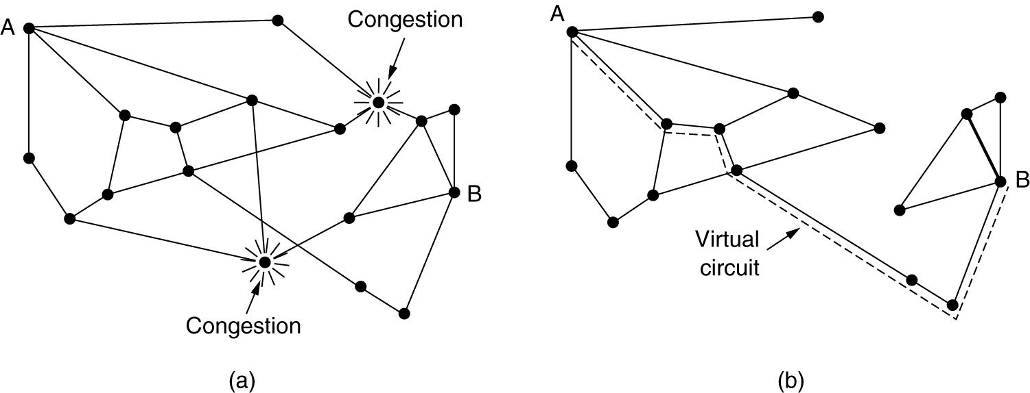
Congestion Control in Virtual-Circuit Subnets: second approach
(a) A congested subnet. (b) A redrawn subnet, eliminates congestion and a virtual circuit from A to B.

Slide 23
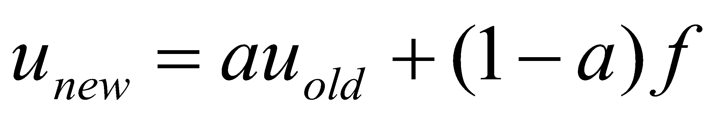
Congestion Control in Datagram Subnets
Each router can easily monitor the utilization of its output lines and other resources.
For example, it can associate with each line a real variable, u, whose value is between 0.0 and 1.0, which reflects the recent utilization of that line.
To maintain a good estimate of u, a sample of the instantaneous line utilization, f (either 0 or 1), can be made periodically and u updated according to
where the constant a determines how fast the router forgets recent history

Slide 24
Congestion Control in Datagram Subnets:
When u moves above the threshold the output line enters a warning state
Each newly-arriving packet is checked to see if its output line is in warning state.
If it is, some action is taken.
The action taken can be one of the following
Warning bit
Choke packets
Load shedding
Random early discard

Slide 25
Warning Bit
A special bit in the packet header is set by the router to warn the source when congestion is detected.
The bit is copied and piggy-backed on the ACK and sent to the sender.
The sender monitors the number of ACK packets it receives with the warning bit set and adjusts its transmission rate accordingly.
As long as the warning bits continued to flow in, the source continued to decrease its transmission rate.
When they slowed to a trickle, it increases its transmission rate

Slide 26
Choke Packets
A choke packet is a control packet generated at a congested router and transmitted to source to inform that there is congestion
A more direct way of telling the source to slow down.
The source, on receiving the choke packet must reduce its transmission rate by a certain percentage.
The original packet is tagged (a header bit is turned on) so that it will not generate any more choke packets further along the path and is then forwarded in the usually way
An example of a choke packet is the ICMP Source Quench Packet.

Slide 27
Working of choke packet
When the source host gets the choke packet, it is required to reduce
the traffic sent to the specified destination by X percent.
• The host should ignore choke packets referring to that destination for a fixed interval.
• After that period has expired, the host listens for more choke packets for another interval.
– If one arrives, the line is still congested. The host reduces the flow still more and begins ignoring choke packets again.
– If no choke packets arrive during the listening period, the host may increase the flow again.

Slide 28
Working of choke packet
Hosts can reduce traffic by adjusting their policy parameters, for example, their window size.
Typically, the first choke packet causes the data rate to be reduced to 0.50 of its previous rate,
Next one causes a reduction to 0.25, and so on

Slide 29
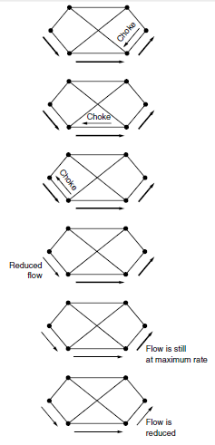
A choke packet that affects only the source.

Slide 30
Hop-by-Hop Choke Packets
Over long distances or at high speeds choke packets are not very effective because the reaction is slow. .
A more efficient method is to send to choke packets hop-by-hop.
This requires each hop to reduce its transmission even before the choke packet arrive at the source.

Slide 31
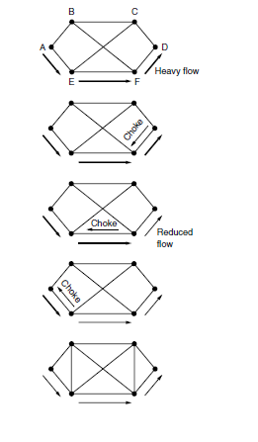
A choke packet that affects each hop it passes through.

Slide 32
Load Shedding
Load shedding is a fancy way of saying that when routers are being flooded by packets that they cannot handle, they just throw them away
When buffers become full, routers simply discard packets
Methods for dropping:
can just pick packets at random to drop
discard may depend on the applications running
For file transfer, an old packet is worth more than a new one
For multimedia, a new packet is more important than an old one.
To implement an intelligent discard policy, applications must mark their packets in priority classes to indicate how important they are.

Slide 33
Load Shedding
senders might be allowed to send high-priority packets under conditions of light load
but as the load increased they would be discarded, thus encouraging the users to stop sending them
Another option is to allow hosts to exceed the limits specified in the agreement negotiated when the virtual circuit was set up (e.g., use a higher bandwidth than allowed)
but subject to the condition that all excess traffic be marked as low priority.

Slide 34
Random Early Discard (RED)
This is a proactive approach in which the router discards one or more packets before the buffer becomes completely full.
To determine when to start discarding, routers maintain a running average of their queue lengths
Each time a packet arrives, the RED algorithm computes the average queue length, avg.
If avg is lower than some lower threshold, congestion is assumed to be minimal or non-existent and the packet is queued.

Slide 35
RED, cont.
If avg is greater than some upper threshold, congestion is assumed to be serious and the packet is discarded.
If avg is between the two thresholds, this might indicate the onset of congestion.
The probability of congestion is then calculated.

Slide 36
Quality of Service
QoS is an overall performance measure of the computer network.
Quality of Service (QoS) refers to the capability of a network to provide better service to selected network traffic .
A stream of packets from a source to destination is called a flow. Quality of Service is defined as something a flow seeks to attain.
The needs of each flow can be characterized by four primary parameters :
Bandwidth
Delay
Jitter
Reliability.

Slide 37
Parameters of flow
Reliability, Lack of reliability means losing a packet or acknowledgement which entertains retransmission.
Delay, Increase in delay means destination will find the packet later than expected..
Jitter, Variation of the delay is jitter, If the delay is not at a constant rate, it may result in poor quality.
Bandwidth, Increase in bandwidth means increase in the amount of data which can be transferred in given amount of time

Slide 38
Jitter Control
The variation (i.e., standard deviation) in the packet arrival times is called jitter.
High jitter, for example, having some packets taking 20 msec and others taking 30 msec to arrive will give an uneven quality to the sound or movie.

Slide 39
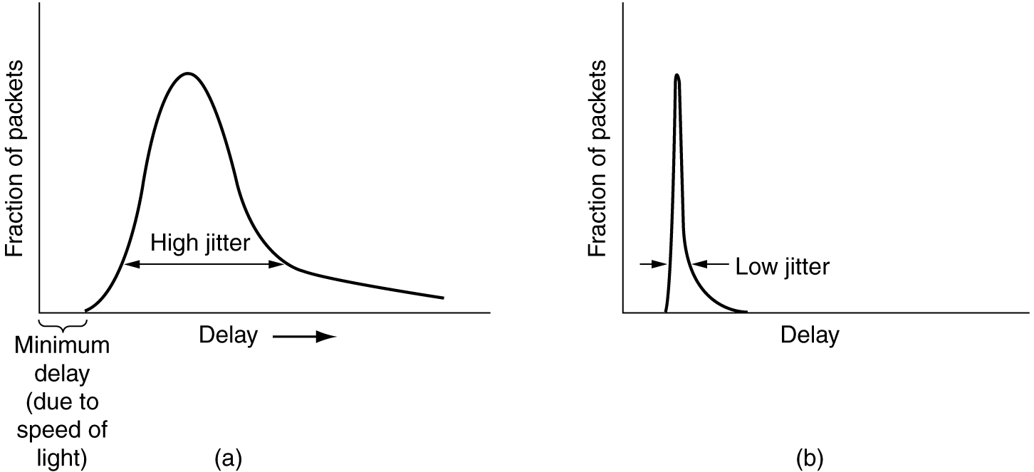
Jitter Control
(a) High jitter. (b) Low jitter.

Slide 40
Jitter Control
The jitter can be controlled by computing the expected transit time for each hop along the path.
When a packet arrives at a router, the router checks to see how much the packet is behind or ahead of its schedule.
This information is stored in the packet and updated at each hop.
If the packet is ahead of schedule, it is held just long enough to get it back on schedule.
If it is behind schedule, the router tries to send it out quickly.
both cases reducing the amount of jitter
In applications such as video on demand, jitter can be eliminated by buffering at the receiver and then fetching data for display from the buffer instead of from the network in real time.
In real time applications like Internet telephony & videoconferencing, the delay inherent in buffering is not acceptable.

Slide 41
Techniques of achieving QoS
Over Provisioning.
Buffering.
Traffic Shaping.
Resource Reservation.
Admission Control.
Proportional Routing.
Packet Scheduling .

Slide 42
Techniques of achieving QoS
Overprovisioning – The logic of overprovisioning is to provide greater router capacity, buffer space and bandwidth.
It is an expensive technique as the resources are costly. Eg: Telephone System.
Buffering – Flows can be buffered on the receiving side before being delivered.
It will not affect reliability or bandwidth, but helps to smooth out jitter.
This technique can be used at uniform intervals.

Slide 43
Traffic Shaping
It is one of the open loop mechanism to manage congestion
This mechanism converts uneven flow of packets in to even flow
“shape” the traffic before it enters the network
Used in ATM and Integrated Services networks.
Two traffic shaping algorithms are:
Leaky Bucket
Token Bucket

Slide 44
The Leaky Bucket Algorithm
The Leaky Bucket Algorithm used to control rate in a network.
It is implemented as a single-server queue with constant service time.
If the bucket (buffer) overflows then packets are discarded.

Slide 45
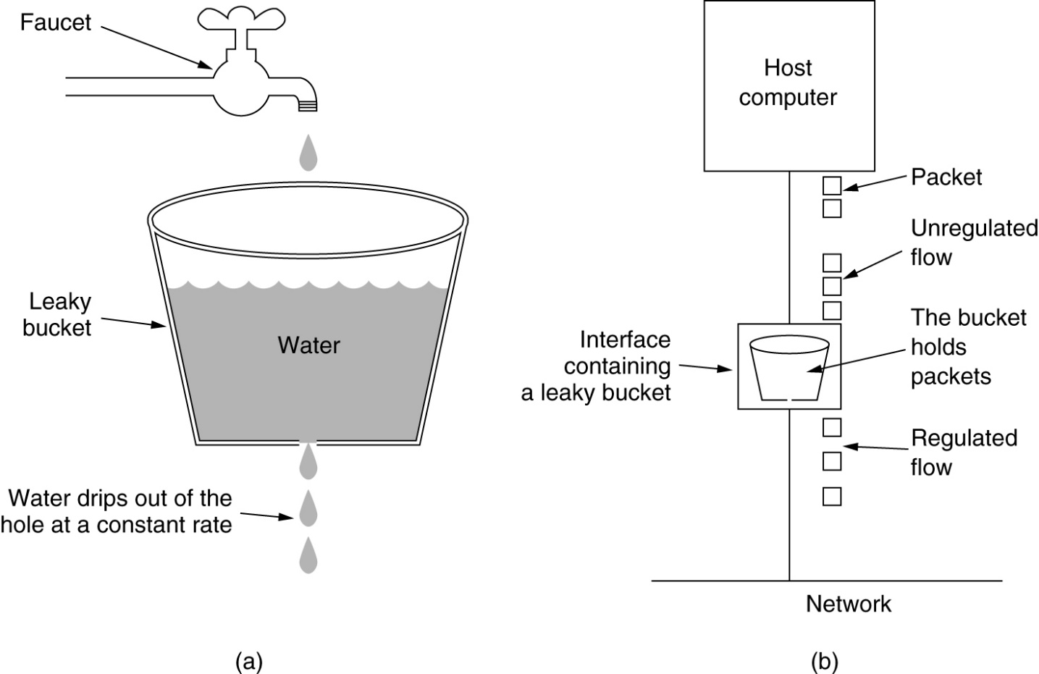
The Leaky Bucket Algorithm
(a) A leaky bucket with water. (b) a leaky bucket with packets.

Slide 46
Leaky Bucket Algorithm, cont.
Imagine a bucket with a small hole in the bottom, as illustrated in Fig.
No matter the rate at which water enters the bucket, the outflow is at a constant rate, R, when there is any water in the bucket and zero when the bucket is empty.
Also, once the bucket is full to capacity B, any additional water entering it spills over the sides and is lost.
Same concept can be applied to a network

Slide 47
Leaky Bucket Algorithm, cont.
Each host is connected to the network by an interface containing a leaky bucket that is a finite internal queue.
If a packet arrives at the queue when it is full the packet is discarded
The host injects one packet per unit time onto the network.
This results in a uniform flow of packets, smoothing out bursts and reducing congestion

Slide 48
Leaky Bucket Algorithm, cont.
The leaky bucket enforces a constant output rate (average rate) regardless of the burstiness of the input.
Does nothing when input is idle.
When packets are the same size (as in ATM cells), the one packet per unit time is okay.
For variable length packets though, it is better to allow a fixed number of bytes per unit time.
E.g. 1024 bytes per unit time will allow one 1024-byte packet or two 512-byte packets or four 256-byte packets.

Slide 49
Token Bucket
The leaky bucket algorithm enforces output patterns at the average rate, no matter how busy the traffic is.
So, to deal with the more traffic, we need a flexible algorithm so that the data is not lost.
One such approach is the token bucket algorithm.

Slide 50
Token bucket algorithm steps
Step 1 − In regular intervals tokens are thrown into the bucket f.
Step 2 − The bucket has a maximum capacity f.
Step 3 − If the packet is ready, then a token is removed from the bucket, and the packet is sent.
Step 4 − Suppose, if there is no token in the bucket, the packet cannot be sent.

Slide 51
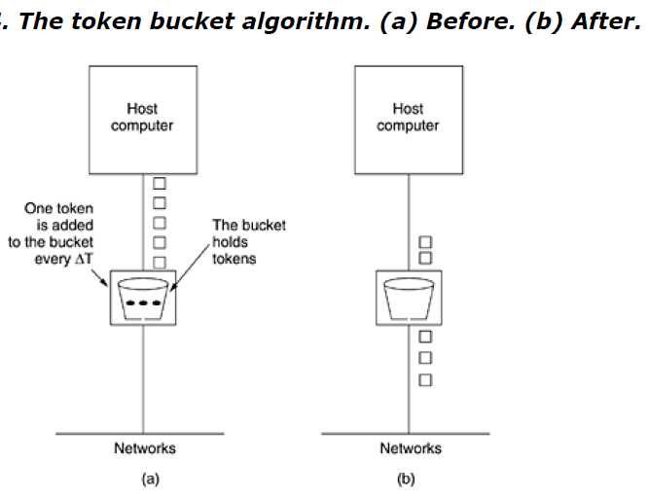

Slide 52
In Fig. (a) there is a bucket holding three tokens, with five packets waiting to be transmitted.
For a packet to be transmitted, it must capture and destroy one token.
In Fig. (b) three of the five packets have been transmitted, but the other two are stuck waiting for two more tokens to be generated

Slide 53
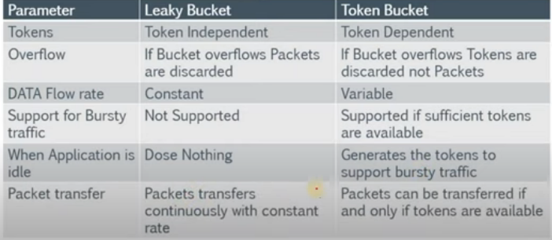
Difference between leaky bucket and token bucket

Slide 54
RESOURCE RESERVATION
A flow of data needs resources such as a buffer, bandwidth, CPU time, and so on.
The quality of service is improved if these resources are reserved beforehand.
Three different kinds of resources can potentially be reserved:
1. Bandwidth.
2. Buffer space.
3. CPU cycles.

Slide 55
Admission Control
Admission control refers to the mechanism used by a router, or a switch, to accept or reject a flow based on predefined parameters called flow specifications.
Before a router accepts a flow for processing, it checks the flow specifications to see if its capacity (in terms of bandwidth, buffer size, CPU speed, etc.) and its previous commitments to other flows can handle the new flow.

Slide 56
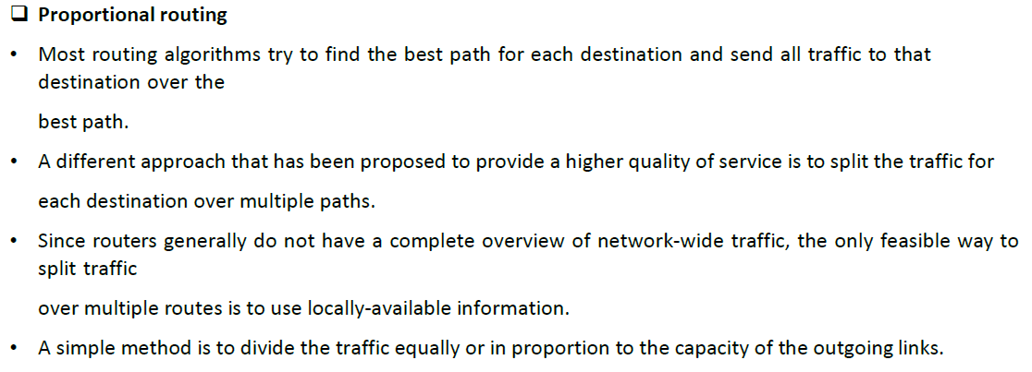

Slide 57
Packet Scheduling
Packets from different flows arrive at a switch or router for processing.
A good scheduling technique treats the different flows in a fair and appropriate manner.
Several scheduling techniques are designed to improve the quality of service.
Three of them are:
FIFO queuing
Priority queuing
Weighted fair queuing.

Slide 58
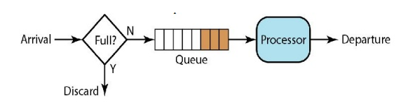
FIFO Queuing
In first-in, first-out (FIFO) queuing, packets wait in a buffer (queue) until the node (router or switch) is ready to process them.
If the average arrival rate is higher than the average processing rate, the queue will fill up and new packets will be discarded

Slide 59
Priority Queuing
In priority queuing, packets are first assigned to a priority class.
Each priority class has its own queue.
The packets in the highest-priority queue are processed first.
Packets in the lowest- priority queue are processed last.

Slide 60
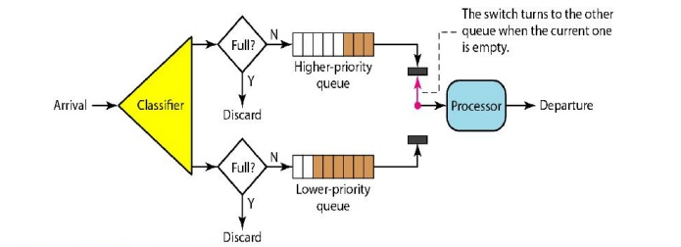
Priority Queuing

Slide 61
Weighted Fair Queuing
In this technique, the packets are still assigned to different classes and admitted to different queues.
The queues, however, are weighted based on the priority of the queues; higher priority means a higher weight.
The system processes packets in each queue in a round-robin fashion with the number of packets selected from each queue based on the corresponding weight.
For example, if the weights are 3, 2, and 1, three packets are processed from the first queue, two from the second queue, and one from the third queue.

Slide 62
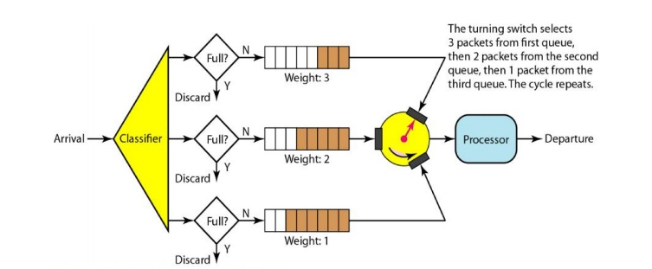
Weighted Fair Queuing

